Slide 1
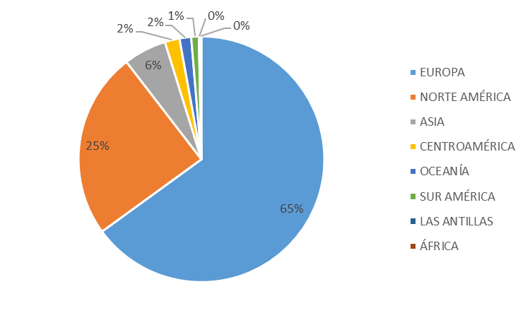

Slide 2
Bloque de Países | Volumen 46Kg | %
EUROPA | 4,667,972.94 | 65.00%
NORTE AMÉRICA | 1,764,242.73 | 24.56%
ASIA | 404,660.49 | 5.63%
CENTROAMÉRICA | 139,338.13 | 1.94%
OCEANÍA | 109,943.42 | 1.53%
SUR AMÉRICA | 72,314.00 | 1.01%
LAS ANTILLAS | 13,301.96 | 0.19%
ÁFRICA | 10,252.50 | 0.14%
Total | 7,182,026.17 | 100%

